Slide 1

Analysis of ICAO’s Market-based Mechanism: Strawman v1.1
Source: flyingclean.com
Parth Vaishnav, Pedro Piris-Cabezas, Rafael Grillo, Annie Petsonk, Paul Fischbeck, Granger Morgan
Notes:
ICAO is the international civil aviation organization: it makes the rules for international aviation; mainly to ensure safety, but also about pollution. There currently are ICAO regulations dealing with NOx and noise
In October 2013, ICAO declared that it would define a market based mechanism to cap emissions from aviation at 2020 levels. This mechanism will be voted upon in the ICAO assembly meeting of 2016, and come into force from 2021 onwards.

Slide 2
Study done during internship at the Environmental Defense Fund
Objectives of study done at EDF
  Understand the impact of ICAO’s proposal on representative airlines
  Where would the offsets come from?
  Understand how the ICAO scheme would be implemented under local law
    Arguments for EPA to issue endangerment finding
    How it would be implemented in India
Notes:
ICAO published a draft of it proposed mechanism last Spring, with a view to gathering feedback from stakeholders.
This circle of stakeholders was closed – the details of the scheme are essentially worked on in secret
I did an internship last summer with Annie at EDF; so I had the chance to analyse this mechanism. We worked on a number of things, but perhaps the most important was trying to work out what obligations the mechanism would place on real airlines. That is the work I am going to discuss now.
Incidentally, this document that outlined the mechanism is now public

Slide 3
ICAO’s proposed scheme: Outline
Initial offset obligations
Final offset obligations
Reserve: difference between reference year and 2020 emissions
Emissions covered by mechanism
Total emissions in year X ≥ 2021
Reference year emissions:
Average of emissions in 2018-20
De-minimis exemption: assumed for this analysis to be 0
Notes:
I’ll begin by outlining the ICAO mechanism
First you have a hopefully small tranche of emissions that is exempt from the mechanism. These are humanitarian or firefighting flights, but also flights in and out of countries who make a small contribution international emissions from civil aviation. For the purpose of this analysis, I am going to ignore this tranche, but will make some comments about it at the end.
The mechanism then defines reference year emissions: the average of the emissions that took place in 2018, 19, 20
In any given year, in the first instance, airlines would have to offset the difference between the sectors total emissions in that year – excluding the de minimis exemption – and the reference year emissions
If this were all, the sector would be cutting emissions to below 2020 levels.
But this is not all – the difference between 2020 emissions and the reference emissions is put into a notional reserve.
This reserve is used to reduce the obligations of airlines that meet certain criteria: mainly, if they are growing very fast, or are very efficient
So, once you reduce the offset obligations of some airlines, what you are left with is an offset obligation that will get emissions down to 2020 levels.

Slide 4
ICAO’s proposed scheme: Determining airlines’ initial offset obligations
Collective part of offset
Growth in industry emissions relative to reference year
Airline’s emission share in current year
50%
Airline’s initial offset obligations
Growth in airline’s emissions relative to reference year
50%
Individual part of offset
Notes:
This shows how each airline’s initial obligation is calculated. That is, the green part.
It’s done in two parts:
First, find out how much the industry has grown between the reference year and now.
Multiply this number by the airline’s current emissions share.
Second, calculate the airline’s own growth in emissions relative to its reference emissions.
Average both these numbers – that gives you the airline’s initial offset obligation in that year.

Slide 5
ICAO’s proposed scheme: Determining airlines’ “fast-growth compensation”
Notes:
Now that we have discussed how ICAO goes about distributing the green part between airlines; we come to the rules for distributing half of the purple part here.
That half is meant to be used to reduce the offset obligations of airlines that grow very fast

Slide 6
ICAO’s proposed scheme: Determining airlines’ “fast-growth compensation”
Repeat for every airline
Compensation = (Airline’s emissions in reference year) * (b-2a)
Compensation as calculated
a = % growth in industry emissions relative to reference year
No
Yes
Is total compensation > 50% of reserve
Is b > 2 x a?
Yes
b = % growth in airline’s emissions relative to reference year
No
Constrained compensation = Compensation x 50% of reserve / total compensation
Airline ineligible for compensation
Repeat for every year
Notes:
You start out by calculating the percentage growth of the industry’s emissions since the reference year, and then the percentage growth in each airline’s emissions
You compare these two: if the airline’s cumulative growth was less than two times that of the industry, it does not get any compensation
If it is greater, then it does get compensation, which is calculated as its emissions in the reference year times the difference between its growth and two times industry growth
We repeat this calculation for every airline.
If the total sum of the compensation for all airlines is less than half the reserve – the height of that purple rectangle – then you reduce each airline’s offset obligation by its calculated compensation.
If it exceeds that number, then you need to calculate the constrained compensation: you distribute the reserve in proportion to the compensation each airline would have received had there been no constraint

Slide 7
Current (2012) emissions based on data collected by David Southgate
David Southgate’s data on number of 2012 flights by airline-origin-destination-a/c type
  Data capture ~70% of sectorial emissions
  Emissions and fuel burn are calculated, based on assumed load factors
Notes:
Anyway, pressing on.
To figure out how the proposal would affect airlines, we had to project their future emissions
We started with current emissions/ These data are very hard to come by. We were fortunate enough to be given a dataset of 2012 emissions by origin, destination, airline, and aircraft type assembled by David Southgate.
From 2004 to 2012 Dave was the Australian Government representative on the United Nations International Civil Aviation Organization (ICAO) Committee on Aviation Environmental Protection (CAEP).
The data are reasonably complete – they match well with external sources of data.
They do not contain data on freight emissions, which were estimated using other data sources

Slide 8
Estimating future emissions and calculating offsets based on strawman
Typical aircraft service life
Airline greenhouse gas emissions in year 2012
Current fleet size
Airline greenhouse gas emissions in year Y > 2012
Improvements in efficiency
Current fleet age
Aircraft currently on order
Airbus forecasts for regional traffic growth
Current network footprint
Notes:
We forecast future emissions for about 100 airlines by combining 2012 emissions with information on these airlines
This included their fleet size, fleet age, the size of their order books, their geographical footprints, Airbus’s forecasts on how much each region group was expected to grow and assumptions about how long aircraft could be operated before they retired, and about potential gains in efficiency
This is a very basic model – we just wanted a very rough estimate of how different sorts of airlines would grow over time

Slide 9
Clustering to discuss results in a way that is not commercially sensitive
Notes:
Based on this, we calculated the offset obligations of individual airlines. However, we did not want to discuss these publicly, in case they raised commercial hackles.
So, we had to find a way of discussing how emissions would affect different types of airlines.
We tried to manually identify airlines we thought typified a certain size category and growth rate, but – even though we anonymized them - we found that people found it very easy to recognize them
So we tried this alternative approach, where we used hierarchical cluster analysis to find groups of airlines that had similar characteristics. We then reported the offset obligations and characteristics of the entire group; so that individual airlines were – hopefully – not easily identifiable.

Slide 10
Nine diverse clusters of airlines formed
Notes:
These are the groups we got: various combinations of domestic and international footprints, fleet age, and – importantly from the point of view of the strawman – the growth rate and size
Group G deserves special mention here. We calculated the growth rate based on the weighted average of all the airlines in the group. However, the offset calculations were done for individual airlines, and not the entire group. So, even though Group G as a whole does not grow at 2 times industry average, there are airlines in there that do. Some of these would then be responsible for fast-growth compensation
Finally, the zero growth assumption on airline D is exogenously imposed to see what the obligations would be for an airline that did not grow or grew very slowly.
The strawman does not say how it would treat an airline that was shrinking; so we have not tested that case

Slide 11
The strawman proposal would cap emissions at 2020 levels (*)
(*) depending on how the text is interpreted
Notes:
So, the most important result is that – if our interpretation of the strawman is correct – then it would cap emissions at 2020 levels plus the de minimis exemption.
It does so by forcing airlines that are currently very large to offset emissions to below 2020 levels; thus allowing room for smaller airlines to grow their emissions and still keep the sector at 2020 levels.
In the thesis, I outline a number alternative interpretations, which are all plausible based on the text of the document, which would not cap emissions at 2020 levels.

Slide 12
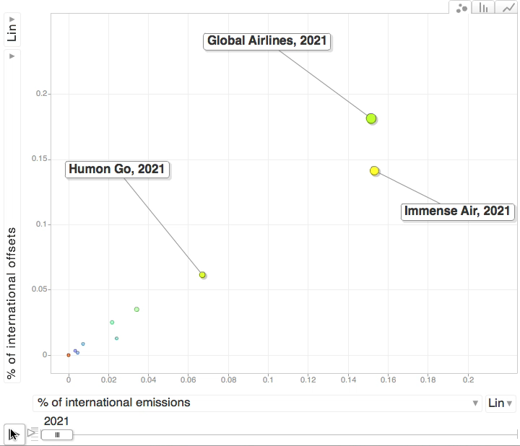
Relationship between share of emissions and share of offsets is different for different types of airlines
20%
15%
10%
5%
0%
0%
2%
4%
6%
8%
10%
12%
14%
16%
18%
20%
Notes:
The relationship between an airline’s share of international emissions and the share of total offsets it must buy is therefore complicated, and evolves over time
In this chart, the x axis represents the percentage of total international emissions that a particular cluster of airlines is accountable for. The numbers are not percentages: 0.2 means 20%
The y axis represents the percentage of total international offsets that each cluster of airlines must buy in any given year
The red line is the 45 degree line. Clusters that are above this line in a given year are responsible for buying a larger share of offsets than their share of international emissions
The size of the dot is proportional to the absolute magnitude of the offsets the airlines have to buy
Now let’s see how this evolves over time
The airlines in clusters G, H, and I are all quite large airlines, except that G is obviously growing a lot faster than H and I – this is why it is offsetting a larger share of the sector’s emissions than H and I. Remember that an airline’s offset obligations are a function of its own emissions share, and its growth in emissions since the reference year
The kink you see here is because G’s offset obligations are trimmed by the fast-grower’s compensation. This is a big deal in the first couple of years, but then the size of the reserve becomes a smaller and smaller fraction of the the total emissions that the airline has to offset. This does not happen in a continuous fashion. Until you reach the point where the total compensation to all the airlines exceeds the size of the reserve, the compensation grows in step with the offset obligations. Once the total compensation gets to the size of the reserve, the compensation does not grow, but the offset obligations keep growing. That is why you see a change in the trajectory

Slide 13
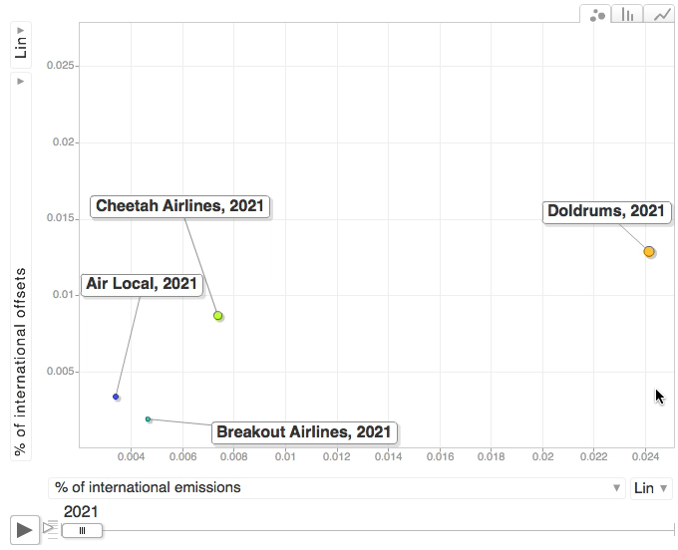
Relationship between share of emissions and share of offsets is different for different types of airlines
2.5%
2.0%
1.5%
1.0%
0.5%
0.4%
0.6%
0.8%
1.0%
1.2%
1.4%
1.6%
1.8%
2.0%
2.2%
2.4%
Notes:
That pattern is even more pronounced for smaller airlines, which start out by being responsible for a much smaller share of offsets than they are for emissions
After 2024, which is when the reserve is exhausted, their obligations rise much faster than their share of emissions
So, you can speculate about whether this is fair, or it serves any reasonable purpose. What you can say for sure is that this is complex, and introduces distortions in the market: why would relatively small airlines such as B – which even in 2035 – would constitute less than 2% of the market be happy to offset a much larger proportion of their emissions than airlines such as H or I, which – even in 2035 would constitute about 8-10% of the market.
It would be as if my tax rate was calculated not just based on my income, but based on how much my income had grown since the past year

Slide 14
Conclusions
Mechanism must be simplified
Monitoring, reporting, and verification
Offsets must satisfy several requirements: some mutually contradictory
  Focus on the ones that are easy to measure (e.g., ubiquity) should not result in compromises on the ones that are not (e.g., integrity)
Notes:
Our conclusions were as follows.
This is a very complicated mechanism. It’s not clear that the complexity serves any purpose: ICAO would do well to simplify it.
The draft of the strawman said very little about monitoring, reporting and verification. There is a little bit of a discussion about how different approaches to calculating emissions from ships results in very different answers. The IMO has now produced three generations of greenhouse gas reports, and has slowly tried to whittle away at the discrepancies and built some legitimacy around what might be the correct way of estimating emissions. ICAO hasn’t done any of this work
Also, it says nothing about what counts as a reasonable offset. You want these offsets to satisfy many conditions; some mutually contradictory. There is a risk that things that can be easily measured – like whether a particular form of offset is ubiquitous – are given priority over things that are more difficult to measure – like whether the offset has real integrity.
Also, this is a market which won’t self-police very well: the seller wants to be able to sell dodgy offsets and buyers want to be able to buy them. It’s the regulator who wants the quality of the offsets to be good.
they must represent real, quantifiable reductions in GHG emissions,
should be economically well-behaved (not too volatile in price or quantity),
there should be a relatively large, broad supply at a reasonable price…
they should provide an economic incentive for airlines to cut their own emissions

Slide 15
Acknowledgements
Granger Morgan, Paul Fischbeck, Annie Petsonk
This work was supported by the center for Climate and Energy Decision Making (SES-0949710), through a cooperative agreement between the National Science Foundation and Carnegie Mellon University and by Academic Funds through the Department of Engineering and Public Policy from the CIT Dean’s Office.
Much of the work on the ICAO market-based mechanism was done during an internship at the Environmental Defense Fund (EDF), which was supported by the chief scientist of the EDF.

