Slide 1
How can policymakers help immature technologies cross the “valley of death”? The case of metallic additive manufacturing for aviation
Jaime Bonnín Roca
Dr. Erica R.H. Fuchs
Dr. Joana Mendonça
Dr. M. Granger Morgan
Dr. Parth Vaishnav
Notes:
Good morning, everyone. Thanks for giving me this opportunity to present on behalf of Erica Fuchs, who had to be in Pittsburgh today
Erica was going to present her work on DARPA. I’m going to present some work that has been done by a student Erica and I co-advise, along with Granger Morgan and Joana Mendonca.
This work is in the process of trying to answer a quite broad question. The valley of death is the chasm that lies between success in the laboratory and commercial success, into which many technologies fall, and fail. What we’re trying to get at, with this research, is figuring out what policymakers can do to help technologies survive that transition
We consider the case of metallic additive manufacturing, which is about 30 years old and is in the process of transitioning out of the lab, and we ask what can be done to help its adoption in the aviation industry
As we shall discuss, the combination of additive manufacturing and aviation is a somewhat extreme one, and we have learnt some interesting things by studying it

Slide 2
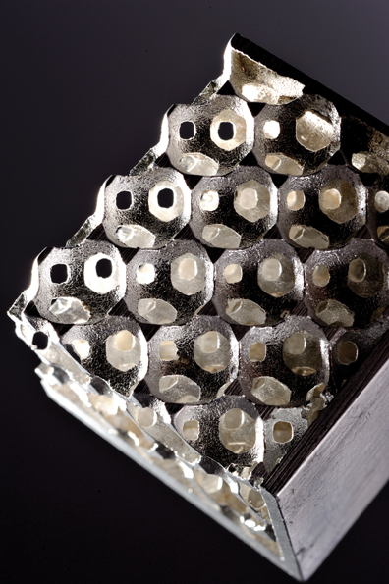
New manufacturing technologies critical to maintain national competitiveness
Metallic additive manufacturing (MAM)
3-D printing with metals
In 2012, America Makes, the National Additive Manufacturing Innovation Institute was created
Intense competition from China and Europe
DoD is an important stakeholder: funder and customer
Source: machinedesign.com
Notes:
We start off by talking about what motivates our research
First, a quick introduction: metallic additive manufacturing is 3d printing with metals. You build a digital version of a part on a computer, and construct it, later by layer, our of a metallic powder or wire
Second, there is the hopefully uncontroversial premise that for an advanced economy, inventing and mastering new manufacturing technologies is crucial to maintaining national competitiveness
Additive manufacturing is one such technology
In recognition of this, the US created the National Additive Manufacturing Innovation Institute, now called America Makes
The US faces intense competition from China, which seems to be coming at additive with great focus and a lot of resources
In the US, DoD is an important stake holder. It is an important source of funding for America Makes, and a customer for the technologies it develops. So, AM is being seen as crucial not only to commercial, but also to strategic and military competitiveness
And a lot of DoD’s interest in AM has to do with its applications in aviation, which we turn to next

Slide 3
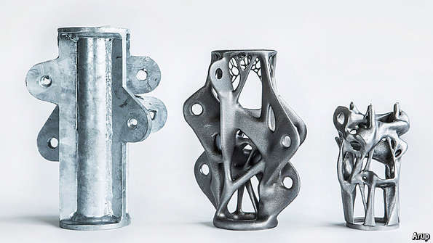
Civil aviation accounts for the largest share of US exports of manufactured goods
MAM offers several advantages that are especially valuable for aeronautics
Reduced development time: one year shorter (GE, 2015)
Production of parts on the field
Reduce material costs, from 20x the weight of the final part to less than 2x (Harris, 2011)
Reduce weight and thus fuel consumption, which represents about 30% of airlines’ operating cost (Pearce, 2014)
(Source: The Economist)
Notes:
Civil aviation is an important sector for the US. Exports of planes, spare parts, and aircraft engines together constitute the largest shore of US exports
Additive manufacturing offers several advantages here
You can make develop new parts quickly
Technically, you can produce different parts in the field using the same machine and the same powder. So you can minimize inventory.
Unlike traditional manufacturing, you don’t have to cut out and essentially throw away a lot of material before you can reveal the form within, as Michelangelo didn’t quite say. So, you waste less expensive, aviation-grade alloy
And you can make very parsimonious shapes, which are impossible to build using traditional manufacturing techniques – so you can reduce weight. This is very valuable to airlines, which spend a lot of money on fuel
This picture illustrates some of these benefits
This is a very angular component, which was probably machined out of a much larger block of metal, most of which ended up as scrap
Its angular because of the limitations of the processes that are used to make these things
Now, if I could print any shape I wanted, I would put material only in those sections of the component that carried a load; I would optimize it. I would also use very close to the amount of material that I actually need.

Slide 4
Acceptable risk of component failure in civil aviation is ~10⁻⁹ per flight hour
MAM is still more art than science
A great deal of technical work needs to be done before MAM is “ready” for aviation
The technology is evolving very quickly
49 manufacturers in 2014; 34 in 2013 (Wohlers Associates 2015)
Average R&D spending was 37.5% of revenues in 2014; 19% in 2013; 16.4% in 2012 (Wohlers Associates 2015)
Regulators (FAA, EASA) must exercise caution; but avoid lock-in (Khaled 2014)
Notes:
The flip side of this happy story is that we currently are not very good at additive manufacturing – it is much more of an art than science
Components made on the same machine at different times may have properties that are different enough that this is a problem in aerospace; and components made on two different units of a notionally identical machine might also be quite different

Slide 5
Decisions made now will affect its viability in a variety of applications
This situation is not new
Composite materials (OTA, 1988)
Optoelectronics (Fuchs and Kirchain, 2010)
Pharmaceuticals (Pisano, 1997)
Semiconductors (Holbrook et al., 2000)
Notes:
- This also means that are made by policymakers, engineers, and in the market will affect what end uses the technology is good for
So, in the case of composite materials, the US government, acting through NASA, actively decided that it would fund a lot of early work that was needed to get them into general, and then civil aviation
Erica showed that, if manufacturers chose to stick with the prevailing technology and made it in the most economical possible way in East Asia, that would limit future applications of certain optoelectronics – a sort of dead end

Slide 6
Research question
What are the main barriers to further implementation of MAM in aviation, and how can they be overcome?
How can policy support the advancement and introduction of early-stage, immature technologies, while still maintaining health and safety standards?
Notes:
To start with some background information: I have made this very brief.

Slide 7
Combination of approaches to answering these question
Collected first-hand information (Eisenhardt, 1989; Glaser & Strauss, 1967)
Interviews (33)
Archival data
What was done with composites?
Process-based cost modeling (with Ria Laureijs)
Participant observation
America Makes meetings
Workshop in Washington D.C. with 25 leaders from government, industry and academia

Slide 8
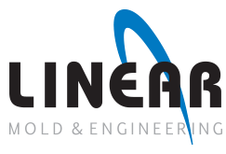
Manufacturers Research Labs Regulators AM suppliers

Slide 9
FINDINGS

Slide 10
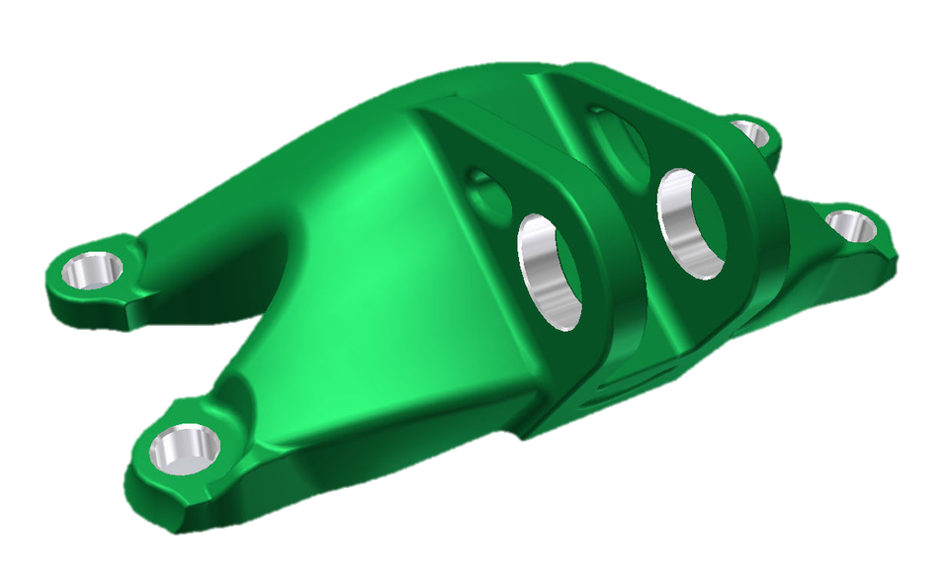
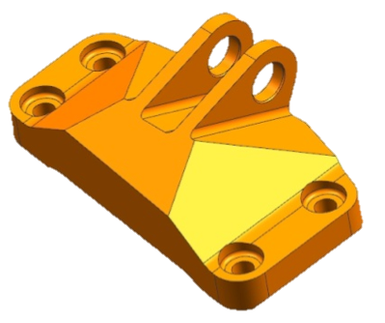
Fuel savings from light-weighting dominate costs (Modeling by Ria Laureijs)
AM TJ2 Design
> 80% Weight Reduction
Fuel Savings: ~$1,300
DMLS 1
Unit Cost ($/Bracket)
Range of costs for AM with current technology
Additional fuel cost due to heavier forgings
Cost of forgings
Annual Production Volume (APV; Bracket/year)
Notes:
I apologize in advance for a very complicated chart.
What we’re looking at here is the cost of producing a load-bearing component of an engine, a bracket
The traditional way to make it is to forge it
And depending on how many you make, the cost of forging it is given by this solid red line – there is some uncertainty, but not a great deal
But you can also design and produce a much lighter component, using 3d printing
Because the technology is immature, you have to do a lot of post-processing and testing, an so its quite expensive to make it that way
The costs are also very uncertain, because there are a lot of technology choices, and we don’t know which ones are okay to make
However, the heavier forging results in a heavier aircraft, and once you account for the extra cost of the fuel needed to carry that weight, AM is competitive, using even just current technology.
The point of this slide is to show that we have reason to believe that the assumptions that motivated out study – that AM is particularly valuable in aviation – do have some empirical basis

Slide 11
FAA regulations for materials and processes in aviation are deliberately broad
Applicant must prove extremely low risk of failure
For common metals and composites, there are material handbooks with FAA-approved mechanical properties
For unstandardized materials like MAM, companies must generate the required data to achieve a certain statistical significance
To account for inherent variability in some technologies, additional safety factors (e.g. casting factors) may be required
Reduces the technology’s potential for light-weighting
Notes:
- We now turn to one of our concerns with the technology
- It is immature, and the Federal Aviation Administration, which is meant to ensure that US aviation is safe sets relatively broad guidelines for materials and processes that are used in aviation
- Basically, the FAA says that you must demonstrate that your component has very low risk of failure
- So, suppose your component is produced by a process which produces components with variable mechanical properties. You can only assume a level of that mechanical property – e.g., strength – that is such that you can be almost certain that almost all of the components produced by the process will be stronger than that number
- To reach that level of statistical confidence, you would have to test a very large number of components
- If the material properties are sensitive to the machine on which the thing is produced, the FAA asks that you do the testing for each combination of design and machine that you use
- Now, in many cases, the FAA has pointed to databases generated, for example, by NASA and said that you can use the material properties that NASA has in this database
In other cases, the FAA has said, you can do less extensive testing, but you must design the component assuming that it is only half as strong as you think it is – this is called an implicit safety factor
If, in the case of additive manufacturing, the FAA decided to apply safety factors and never got rid of them, then that would undermine the advantage of lightweighting

Slide 12
‘Casting factors’ may increase costs between $50 and $1000 per engine bracket
Notes:
- In this chart, Jaime has calculated the cost of the engine bracket we saw a couple of slides ago assuming various safety factors
- The bar at the bottom is drawn assuming that you can design your components using the properties that your testing shows they have
The bar on top shows a safety factor of 2, which means you assume that the component has properties that are only half as good as your testing shows
And obviously, as you ratchet up the safety factor, it becomes more expensive to make the component – because you use more material – and also you use up more fuel carrying it around.

Slide 13
Combination of design, material, process, and mfg. equipment must be certified
Once production starts, the manufacturing equipment is ‘frozen’ and input parameters cannot be changed unless the machine is requalified
A MAM machine only can build the parts for which it is qualified
If producing one part and want to produce a second on the same machine, both designs may need to be requalified
This creates hurdles for one of the potential advantages of MAM – mass customization
Notes:
Our second concern is that, as we discussed before, you have to certify every combination of material, process, design, and piece of equipment
Now, one of the advantages of AM is that you can potentially have just one machine and produce whatever components you want on it
But if your practice, or FAA requirement is that you can only use one machine to produce one design, that advantage goes away.

Slide 14
Depending on how this is implemented, this would raise costs
Assume one machine can produce 500 of whatever component you want to produce
Annual volume of |  | Number of machines needed |  | Average machine utilization
Part A | Part B | One machine-one design | One machine –many designs | One machine-one design | One machine –many designs
100 | 100 | 2 | 1 | 20% | 40%
300 | 300 | 2 | 2 | 60% | 60%
1700 | 1700 | 8 | 7 | 85% | 97%
Notes:
Our second concern is that, as we discussed before, you have to certify every combination of material, process, design, and piece of equipment
Now, one of the advantages of AM is that you can potentially have just one machine and produce whatever components you want on it
But if your practice, or FAA requirement is that you can only use one machine to produce one design, that advantage goes away.

Slide 15
‘One machine – one part’ may increase unit costs by $500-$2,000
2014’s B777 deliveries
[Source: Boeing]
Perhaps a necessary safety precaution during immature stage, but important to avoid lock-in!
Engine Retrofit AM project [Source: private communication]
2014’s B737 deliveries
[Source: Boeing]
Notes:
And you can see that situation here – under

Slide 16
Cross-country questions / lessons for additive manufacturing
In the past, technology developed in the US has been implemented more rapidly elsewhere
Airbus has implemented US-developed fuel savings technology before Boeing (Bowles, 2010)
Today, most AM equipment manufacturers are in Europe; installations in US
Japanese composites manufacturers have made themselves indispensible to Boeing (MacPherson & Pritchard 2007)
A good route to aerospace is to first invest in a manufacturing base where the stakes are not as high as in aerospace
Chinese universities partnered with Airbus to develop MAM (Staff, 2014)
May have greater willingness to “learn by doing”
Some data can only be obtained through flying (RAND, 1992), but history (e.g. Comet fatigue cracks) shows that physical models are also needed
Lessons do not always transfer easily across countries (Zeitlin & Herrigel 2004)
Notes:
Something about TRL 4-7

Slide 17
RECOMMENDATIONS

Slide 18
US Congress must fund and steward the creation of basic knowledge and institutional infrastructure
Collection and dissemination of basic data: public good greater than private interests
Pedigree
Technical and institutional infrastructure for sharing
Cross-agency learning
Govt. has already taken initial steps (GoAdditive)
Successful in the case of the National Nano Technology Initiative (NRC, 2002)
Current funding for America Makes, the National Additive Manufacturing Innovation Institute ~$50 million (Fed.) + $39 million (other)
US Air Force spent $160 million (2014) in 1964-65 on advanced composite R&D
Federal R&D funding for composites was $240 million (2014) in 1987

Slide 19
Standards must be consistent; stringent enough for aviation
NIST has helped create a framework under which ISO and ASTM are issuing joint standards
Standards must be adequately precise for aviation requirements
To produce aerospace-quality components, you may need to tightly control 100 parameters; in other areas, controlling 10 might be enough
Requires careful management by independent actors
If independent standard does not emerge, the best-resourced firm’s standard dominates, regardless of tech. merit (Weiss & Sirbu 1990)
No standard emerges => Fragmented ecosystem (e.g. powder metallurgy)

Slide 20
Opportunities must be created to safely learn by doing
NASA brought airlines and manufacturers together with the ACEE program (Bowles, 2010)
NASA promoted standardization first in General Aviation, where safety requirements are not as stringent (Ilcewicz & Murphy, 2005)
Regulators must avoid lock-in
Perhaps by the use of sunset clauses in rules

Slide 21
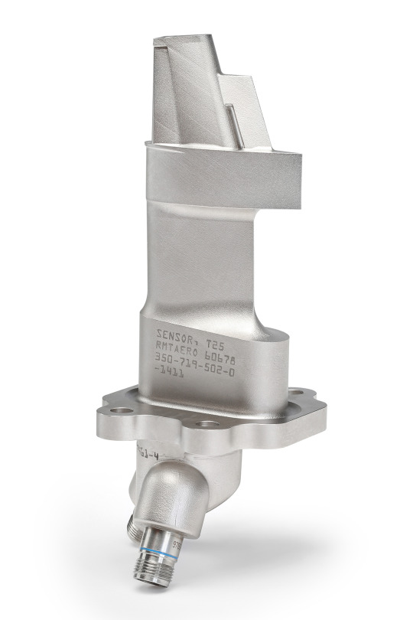
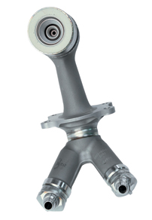
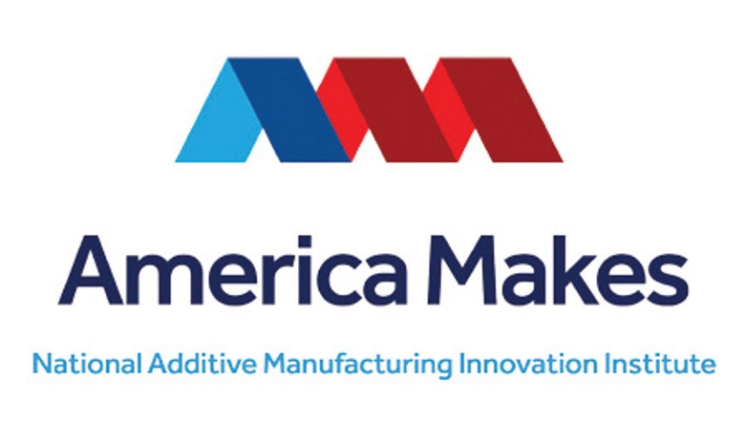
Acknowledgements
(Source: GE)
(Source: GE)

Slide 22
References
Harris, I. D. (2011). Development and Implementation of Metals Additive Manufacturing. DOT International, New Orleans. Retrieved from http://ewi.org/eto/wp-content/uploads/2013/06/Additive-Manufacturing-DOT-Paper-2011.pdf
Pearce, B. (2014, June). Key features of air transport markets – IATA. Retrieved from http://www.slideshare.net/OECD-DAF/some-key-features-of-air-transport-markets-brian-pearce-iata-june-2014-oecd-discussion-on-airline-competition
Office of Technology Assessment. (1988). Advanced Materials By Design.
Fuchs, E., & Kirchain, R. (2010). Design for Location? The Impact of Manufacturing Offshore on Technology Competitiveness in the Optoelectronics Industry. Management Science, 56(12), 2323–2349.
Pisano, G. P. (1997). The Development Factory: Unlocking the Potential of Process Innovation. Harvard Business Press.
Holbrook, D., Cohen, W. M., Hounshell, D. A., & Klepper, S. (2000). The nature, sources, and consequences of firm differences in the early history of the semiconductor industry. Strategic Management Journal, 21(10/11), 1017–1041.
Wohlers Associates, “3D Printing and Additive Manufacturing State of the Industry: Annual Worldwide Progress Report” (2015).
T. Khaled, “Casting Factors” (ANM-112N-13–05, Federal Aviation Administration, 2014).
Eisenhardt, K. M. (1989). Building Theories from Case Study Research. Academy of Management Review, 14(4), 532–550.
Glaser, B. G., & Strauss, A. L. (1967). The discovery of grounded theory; strategies for qualitative research. Aldine Pub. Co.
Bowles, M. D. (2010). The Apollo of Aeronautics: NASA’s Aircraft Energy Efficiency Program, 1973-1987. US National Aeronautics & Space Administration.
Zeitlin, J., & Herrigel, G. (2004). Americanization and Its Limits: Reworking US Technology and Management in Post-war Europe and Japan. Oxford University Press.
A. MacPherson, D. Pritchard, Boeing’s Diffusion of Commercial Aircraft Technology to Japan: Surrendering the U.S. Industry for Foreign Financial Support. J. Labor Res. 28, 552–566 (2007).
Staff. (2014, March 17). Airbus signs deal with China to make aircraft parts using 3D printers. Retrieved August 20, 2015, from http://www.3ders.org/articles/20140317-airbus-signs-deal-with-china-to-make-aircraft-parts-using-3d-printers.html
NRC. 2002. “Small Wonders, Endless Frontiers: A Review of the National Nanotechnology Initiative.” Committee for the Review of the National Nanotechnology Initiative. http://www.nap.edu/catalog/10395.html.
Ilcewicz, L. B., & Murphy, B. (2005). Safety & certification initiatives for composite airframe structure. In STRUCTURAL DYNAMICS AND MATERIALS (SDM) CONFERENCE

